Slide 1


Ecosystems
Trinidad and Tobago

Slide 2
What is an Ecosystem?
An Ecosystem is a community of living and non living things that function together. Within an ecosystem, organisms are interdependent and adapted to the environment. Ecosystems can be as large as deserts or as small as ponds.

Slide 3
Types of Ecosystems
Wetlands/Swamps
Coral Reefs
Rainforests
Deep seas and beaches
Savannahs
Urban Centres like cities

Slide 4
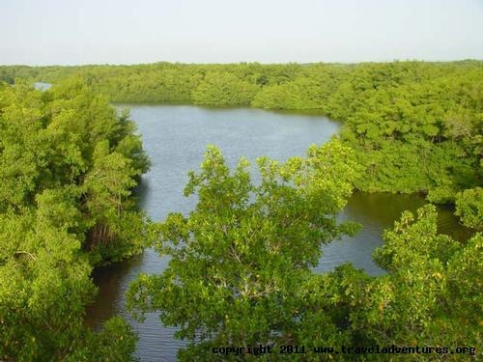
Caroni Swamp

Slide 5
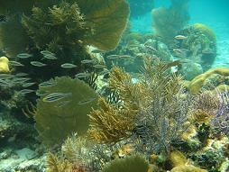
Buccoo Reef - Tobago

Slide 6
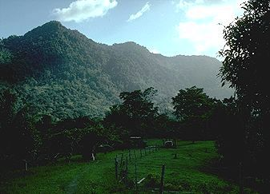
Asa Wright – Northern Range at about 12 000 feet

Slide 7
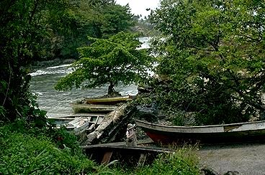
The beach at Blanchisseuse

Slide 8
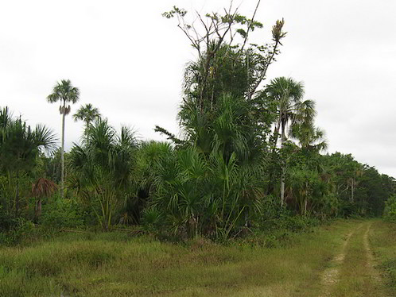
The Aripo Savannah

Slide 9
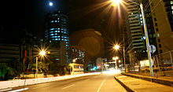
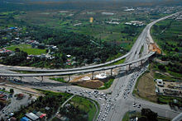
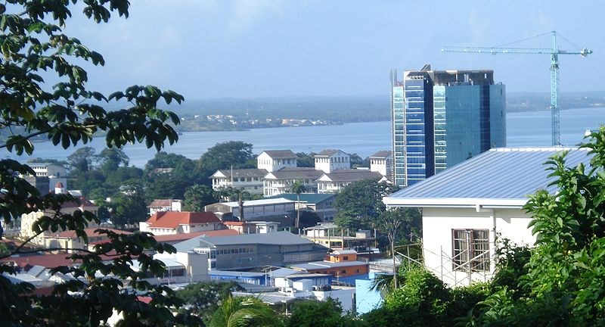
Urban Centres Port of Spain & San Fernando

Slide 10
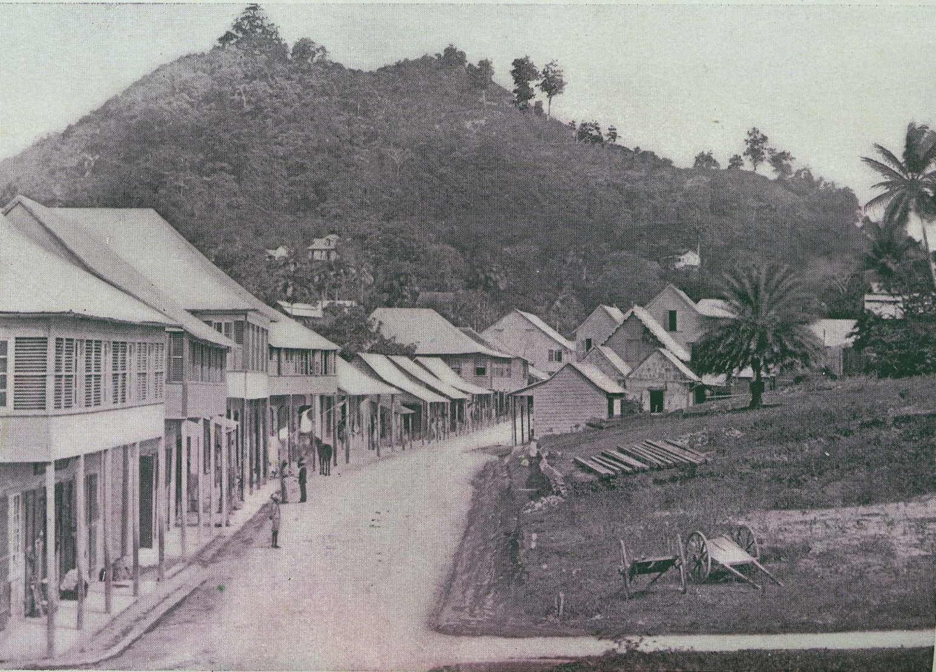
San Fernando Hill prior to Quarrying looking east along High Street in the 1890’s

Slide 11
What are Wetlands?
Wetlands are areas of lands that are covered with water either all or only part of the time. Wetlands include mangroves, coastal lagoons and even coral reefs.

Slide 12
Importance of wetlands
Wetlands protect the coastal areas by trapping soil in the roots of the plants. They also protect the coastal areas from hurricanes and high winds. Destruction of parts of the Kilgwyn wetland in Tobago has increased the threat of storm damage to coastal lands.
Wetlands support a wide variety of plants and animals. There are various food chains and food webs in these wetlands. Some of the animals found in wetlands are crabs, fish, oysters, birds and other wildlife.
Wetlands are nurseries for many species of animals.
Wetlands are ecotourism and recreation sites because of their beauty.
Wetlands act as sponges by retaining floodwaters. The waters are slowly released, helping to control floods
Wetlands filter pollutants and sediments, therefore helping to clean up contaminated waters

Slide 13
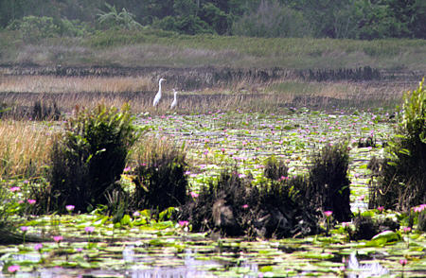
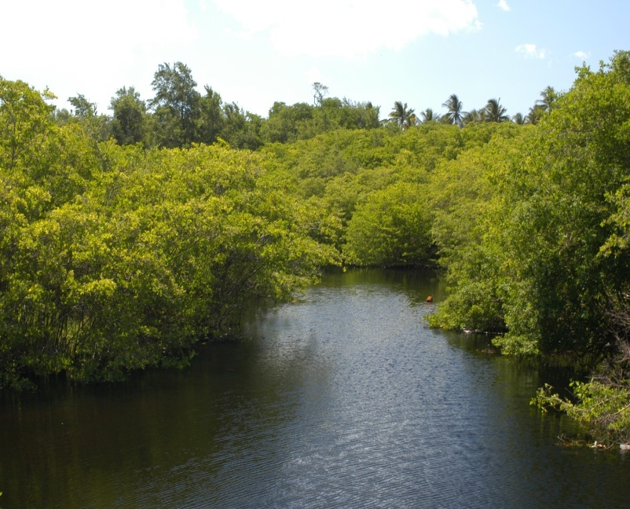
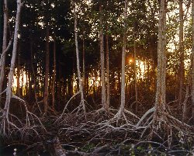
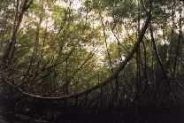
Bon Accord Lagoon
Wetlands of the Pitch Lake
Mangrove roots – Nariva Swamp
Wetlands in Godineaux

